Slide 1
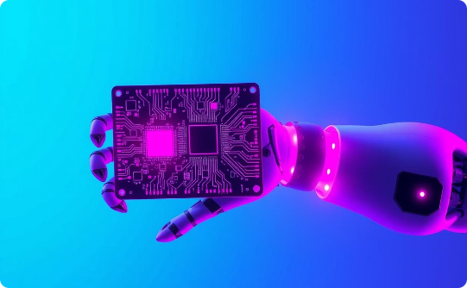
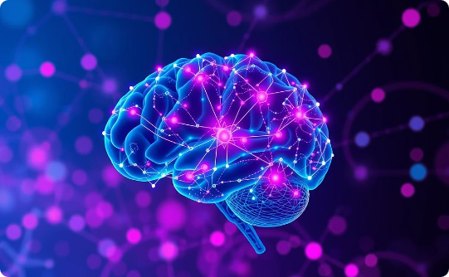
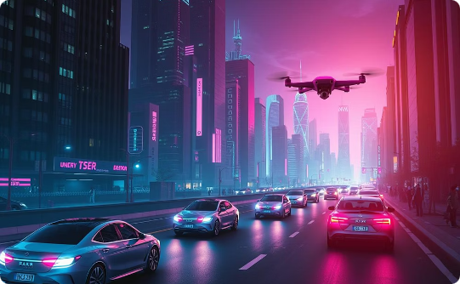
AI: Transforming the Future
Automation
Intelligence
Transformation
AI automates complex tasks.
AI simulates human intelligence.
AI transforms industries and daily life.
Artificial intelligence is rapidly changing our world, impacting everything from business to healthcare. This presentation explores AI's transformative potential through automation and enhanced intelligence.

Slide 2

What is Artificial Intelligence?
AI involves creating machines that mimic human intelligence. This includes learning, problem-solving, and decision-making. It aims to develop systems that can perform tasks that typically require human intelligence, such as visual perception, speech recognition, and complex reasoning.
Machine Learning
Deep Learning
Natural Language Processing
Algorithms that learn from data, improving their performance over time through experience. Examples include predictive models for sales forecasting and recommendation systems for online shopping.
Neural networks with multiple layers, enabling the analysis of complex patterns and abstractions. Applications include image recognition, natural language processing, and autonomous driving.
Enabling computers to understand and generate human language, facilitating communication between humans and machines. This includes applications like chatbots, language translation, and sentiment analysis.

Slide 3




The History and Evolution of AI
A visual journey through the key milestones in AI development.
1950s: The Birth of AI Research
1980s: Expert Systems Emerge
2010s: Deep Learning Revolution
Today: AI is Everywhere
AI's pervasive presence in our daily lives, transforming industries and reshaping how we interact with technology.
The era when the seeds of AI were first sown, marked by groundbreaking theories and the vision of creating thinking machines.
The rise of systems designed to mimic the decision-making abilities of human experts, showcasing AI's potential in specialized fields.
A period of rapid advancement fueled by neural networks, enabling machines to learn and understand complex patterns with unprecedented accuracy.

Slide 4
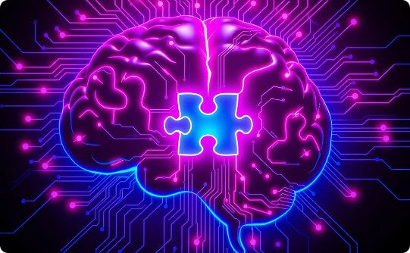

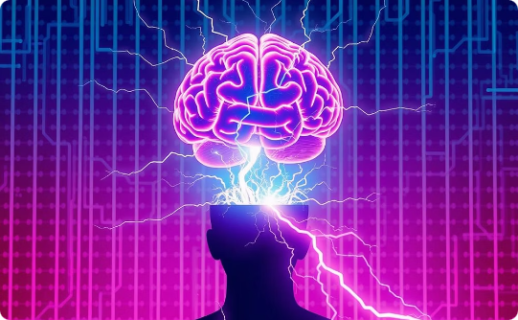
Types of AI: Visualizing Capabilities
Exploring AI's capabilities through illustrative examples.
Narrow AI
General AI
Strong AI
Focused on specific tasks, like playing chess or spam filtering.
Possessing human-level intelligence and adaptability.
Theoretical AI surpassing human cognitive abilities.

Slide 5

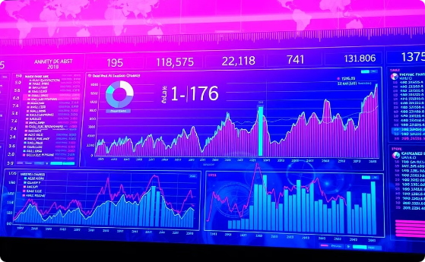
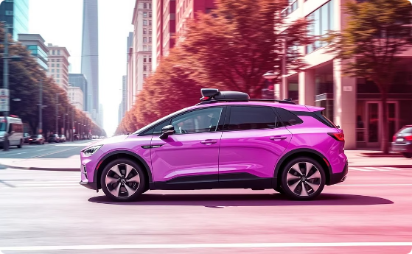
AI Applications Across Industries
Exploring AI's impact with real-world examples.
Healthcare
Finance
Transportation
AI assists in diagnostics and personalized treatment plans. AI algorithms analyze medical images to detect diseases like cancer, predict patient outcomes, and personalize drug dosages. This leads to more accurate diagnoses, improved patient care, and reduced healthcare costs.
AI algorithms enhance risk management and fraud detection. In finance, AI is used to assess credit risk, detect fraudulent transactions, and automate trading decisions. Machine learning models analyze vast amounts of financial data to identify patterns and anomalies, helping financial institutions minimize losses and improve efficiency.
AI-powered autonomous vehicles revolutionize mobility. AI is transforming transportation through self-driving cars, drone delivery systems, and optimized traffic management. Autonomous vehicles use computer vision and machine learning to navigate roads, reduce accidents, and improve traffic flow, promising safer and more efficient transportation systems.

Slide 6
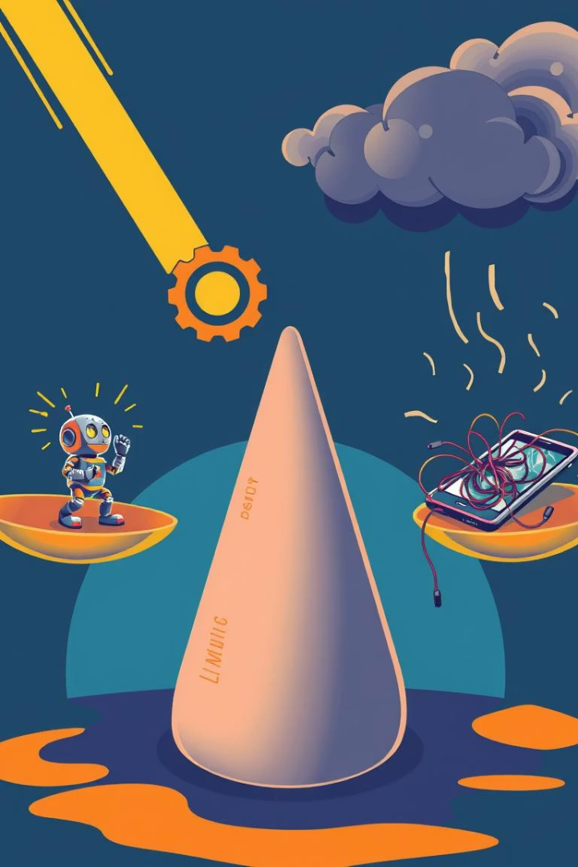


The Benefits and Challenges of AI Adoption
AI offers numerous benefits, but also presents challenges.
Benefits
Increased efficiency
Improved accuracy
Automation of tasks
Challenges
Job displacement
Ethical concerns
Data privacy

Slide 7
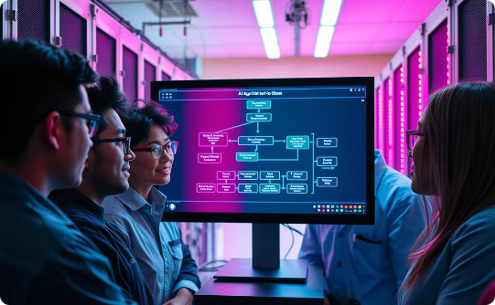
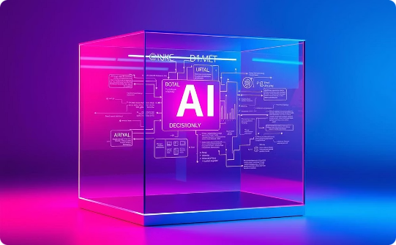
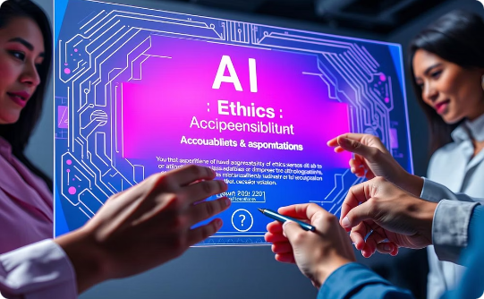
Ethical Considerations and Responsible AI Development
Developing AI ethically is paramount, requiring vigilance to ensure fairness, transparency, and accountability.
Bias Detection
Transparency
Accountability
Identify and mitigate biases in AI algorithms for fair outcomes across diverse groups.
Provide clear explanations of AI decision-making processes.
Establish clear responsibility for AI actions and their consequences.

Slide 8
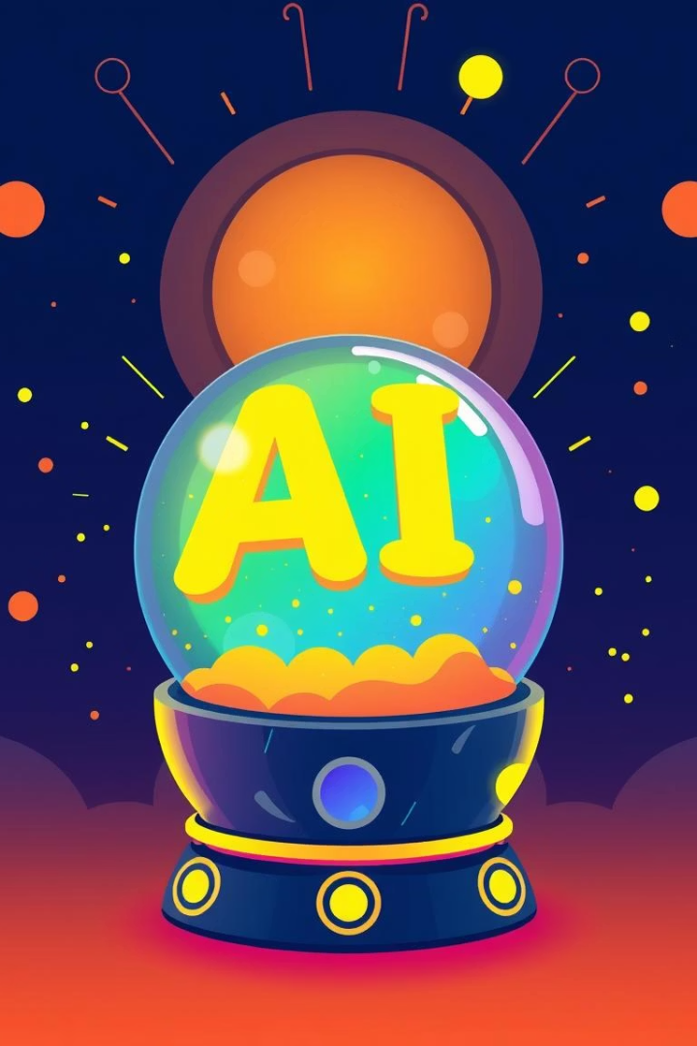



The Future of AI: Trends and Predictions
AI's future is bright and filled with possibilities. Several key trends are shaping its evolution.
AI Democratization
AI tools become more accessible.
Edge AI
AI processing on local devices.
Explainable AI
Making AI decisions understandable.

